Slide 1
CSDS 451: Designing High Performant Systems for AI
Lecture 22
11/13/2025
Sanmukh Kuppannagari
sanmukh.kuppannagari@case.edu
https://sanmukh.research.st/
Case Western Reserve University

Slide 2
Outline
Collective Communication Primitives – Complexity Analysis

Slide 3
Announcements
WA3 Due this Saturday
WA4 Will be Out
Project Proposals Graded
If you did not receive a score, I may have asked you followup questions on your proposal
Please send me weekly updates by responding to the email so that you remain on track

Slide 4
Outline
Last Class Review

Slide 5
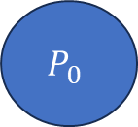
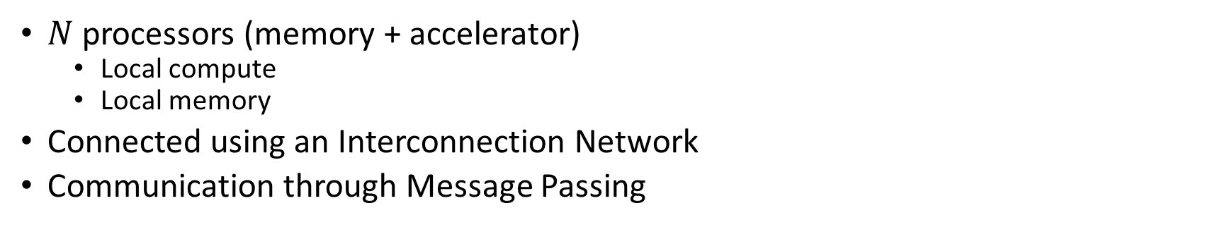
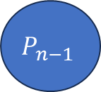
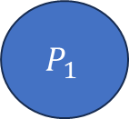
Cluster of Accelerators
$N$ processors (memory + accelerator)
Local compute
Local memory
Connected using an Interconnection Network
Communication through Message Passing
Interconnection Network
$$P_{0}$$
$$P_{1}$$
$$P_{n−1}$$
…

Slide 6
Anatomy of an MPI Program
MPI_Init(…)
MPI_Comm_rank(MPI_COMM_WORLD, &my_rank)
MPI_Comm_size(MPI_COMM_WORLD, &num_procs);
Do rank specific work

Slide 7
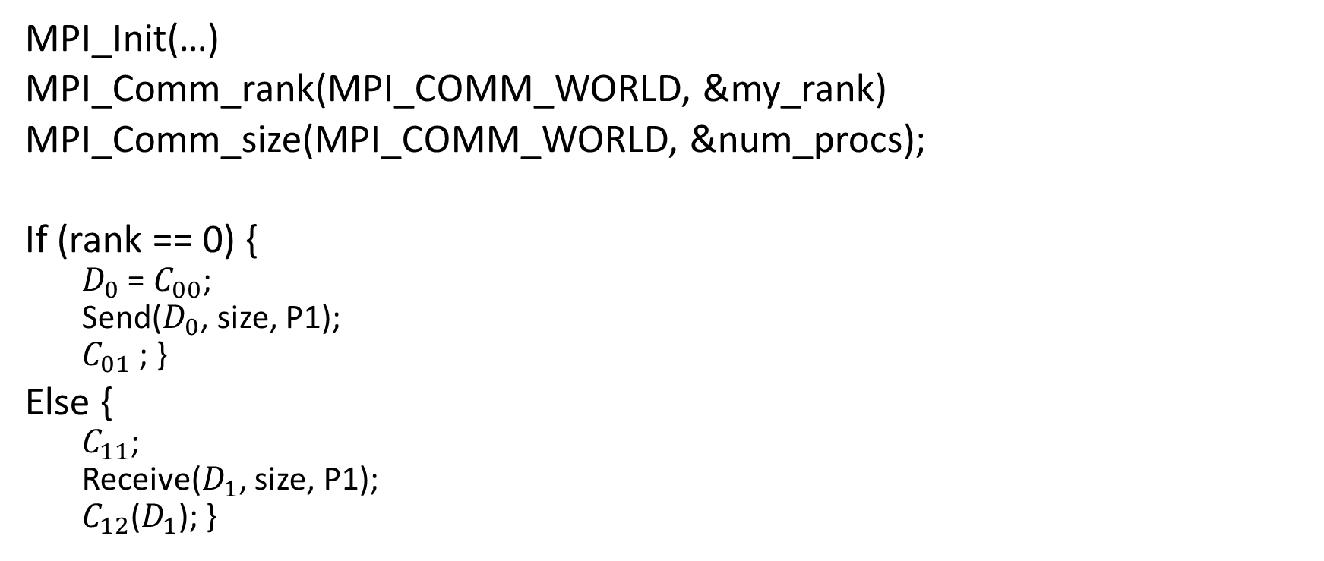
Inter-Process Communication
MPI_Init(…)
MPI_Comm_rank(MPI_COMM_WORLD, &my_rank)
MPI_Comm_size(MPI_COMM_WORLD, &num_procs);
If (rank == 0) {
$D_{0}$ = $C_{00}$;
Send($D_{0}$, size, P1);
$C_{01}$ ; }
Else {
$C_{11}$;
Receive($D_{1}$, size, P1);
$C_{12}$($D_{1}$); }
Rank 0
Rank 1
Data local to program₀
Data local to program₁
Two processor world

Slide 8
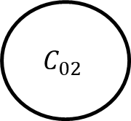
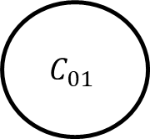
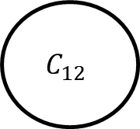
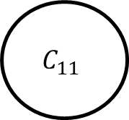
Inter-Process Communication
P0
P1
$$C_{01}$$
$$C_{11}$$
$$C_{02}$$
$$C_{12}$$
Dependency across processors due to communication operation

Slide 9
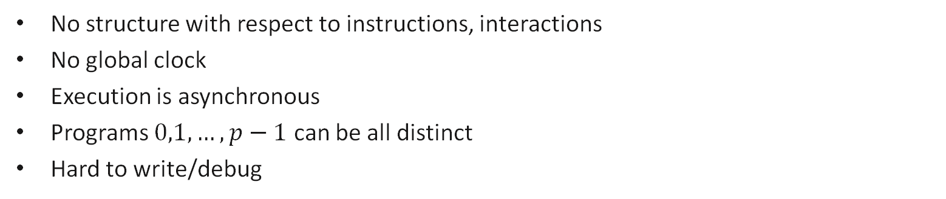
Message Passing Program
Most General Model: Asynchronous
Program₀
Program₁
Program₂
S
S
R
……
R
R
S
R
S = send
R = receive
S
End
End
End
No structure with respect to instructions, interactions
No global clock
Execution is asynchronous
Programs $0,1,…, p−1$ can be all distinct
Hard to write/debug

Slide 10
Message Passing Program
Bulk synchronous
Program₀
Program₁
Program₂
Program₃
Program₄
Computation phase
Communication phase
sync
Two phases to the Program
Computation Phase: Each process executes independently. No communication
Communication Phase: Processes communicate with each other

Slide 11
Message Passing Program
SPMD (Single Program Multiple Data)
Code is same in all the processes except for initialization
Restrictive model, easy to write and debug
Easy to do performance analysis
Widely used in Machine Learning Training
Program₀
Program₁
Program₂
Program₃
Program₄
Program₄

Slide 12
Blocking Non-Buffered Send/Receive
Sending
process
Receiving
process
Sending
process
Receiving
process
Sending
process
Receiving
process
Request
to send
Request
to send
Send
Request
to send
Idle
okay
to send
Send
Idle
okay
Recv.
Recv.
data
Send
okay
Recv.
data
data
Sender comes first;
idling at sender
(b) Sender and Receiver come at about the same time;
idling minimized
(c) Receiver comes first;
idling at Receiver

Slide 13


Virtual Topology
Define the “connectivity pattern” of the processors
Helps us in developing more intuitive notions of message passing algorithms
Think of it as 1D versus 2D arrays. It will be hard to visualize matrix multiplication if we write algorithms using 1D arrays
$$0 1 p−1$$
…
…
$$0 1 p−1$$
…
1D Mesh
…
2D Mesh

Slide 14
Message Passing Programming Paradigm
User Specifies the following
Concurrency Model (BSP, SPMD, None/Asynchronous)
Processes: The number of processes and the work performed for each process
Send, receive that enable data (we will only use blocking non-buffered semantics)
A virtual topology of the processes
We will discuss it at algorithmic level.
Skip initialization, rank calculation, etc.

Slide 15
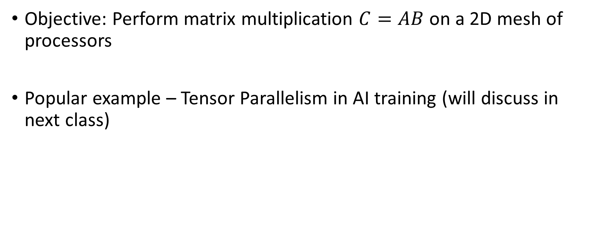
Distributed Matrix Multiplication
Objective: Perform matrix multiplication $C=AB$ on a 2D mesh of processors
Popular example – Tensor Parallelism in AI training (will discuss in next class)

Slide 16
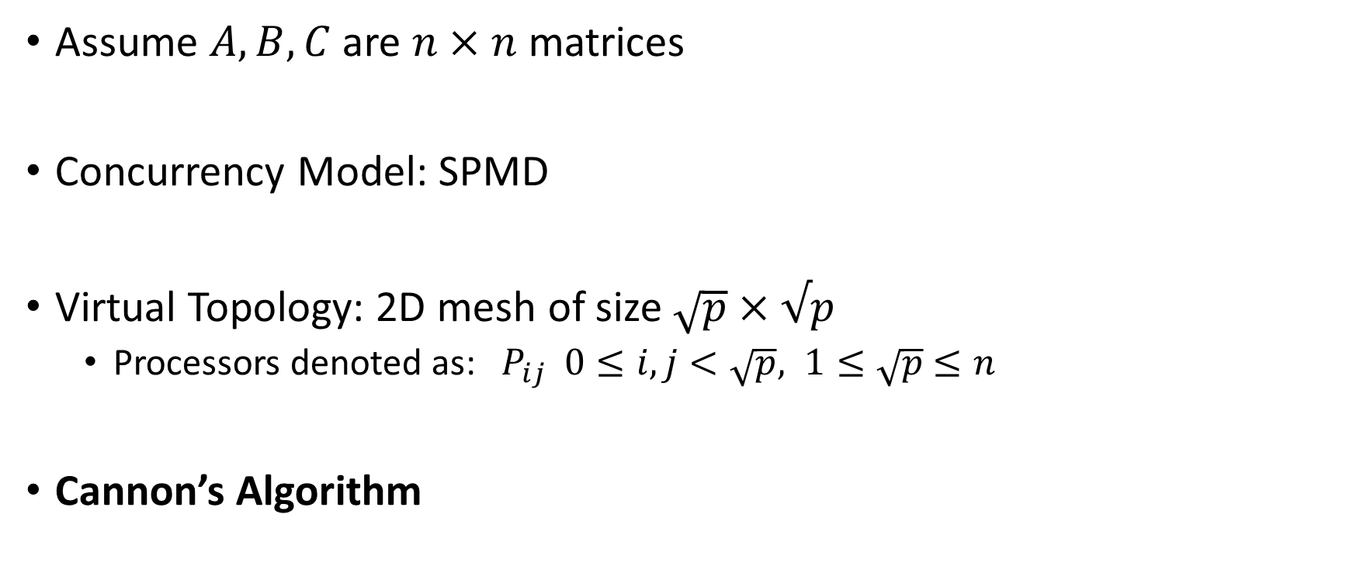
MM on 2D Mesh
Assume $A, B, C$ are $n×n$ matrices
Concurrency Model: SPMD
Virtual Topology: 2D mesh of size $\sqrt{p}×√p$
Processors denoted as: $P_{ij} 0≤i,j<\sqrt{p}, 1≤\sqrt{p}$ $≤n$
Cannon’s Algorithm

Slide 17

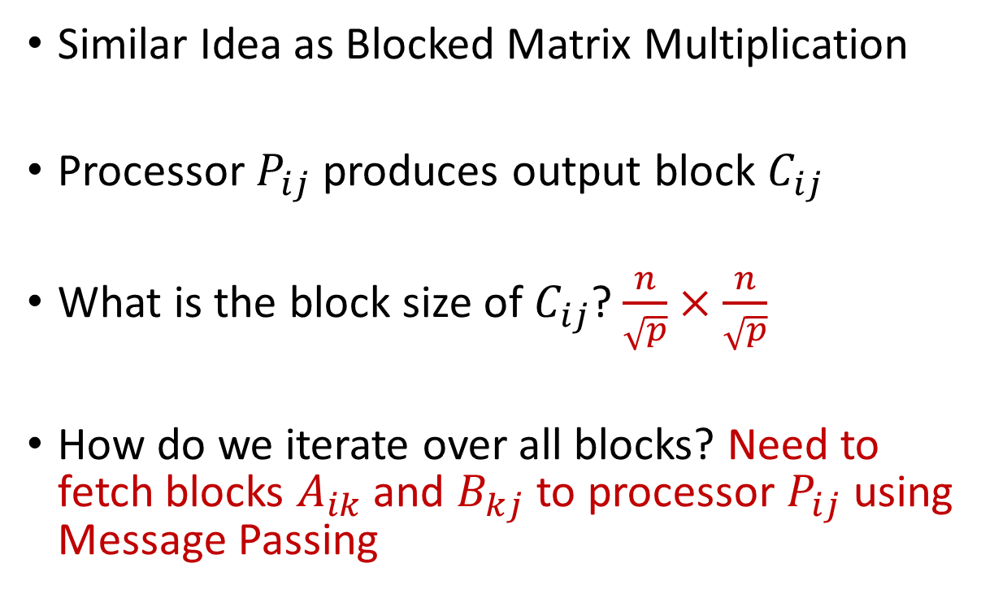


MM on 2D Mesh – Cannon’s Algorithm
Similar Idea as Blocked Matrix Multiplication
Processor $P_{ij}$ produces output block $C_{ij}$
What is the block size of $C_{ij}$? $\frac{n}{\sqrt{p}}×\frac{n}{\sqrt{p}}$
How do we iterate over all blocks? Need to fetch blocks $A_{ik}$ and $B_{kj}$ to processor $P_{ij}$ using Message Passing
$B^{b}[$:,j]
$A^{b}[$i,:]
$C^{b}[$i,j]

Slide 18


MM on 2D Mesh – Cannon’s Algorithm
Circular left shift
Circular up shift
0
1
…
$\sqrt{p}$-1
0
…
$\sqrt{p}$-1

Slide 19
































MM on 2D Mesh – Cannon’s Algorithm
Assume initially $P_{ij}$ has data - $A_{ij}, B_{ij}$
$$A_{0,0}$$
$$A_{0,1}$$
$$A_{0,2}$$
$$A_{0,3}$$
$$B_{0,0}$$
$$B_{1,1}$$
$$B_{2,2}$$
$$B_{3,3}$$
$$A_{1,0}$$
$$A_{1,1}$$
$$A_{1,2}$$
$$A_{1,3}$$
$$B_{1,0}$$
$$B_{1,1}$$
$$B_{1,2}$$
$$B_{1,3}$$
$$A_{2,0}$$
$$A_{2,1}$$
$$A_{2,2}$$
$$A_{2,3}$$
$$B_{2,0}$$
$$B_{2,1}$$
$$B_{2,2}$$
$$B_{2,3}$$
$$A_{3,0}$$
$$A_{3,1}$$
$$A_{3,2}$$
$$A_{3,3}$$
$$B_{3,0}$$
$$B_{3,1}$$
$$B_{3,2}$$
$$B_{3,3}$$

Slide 20
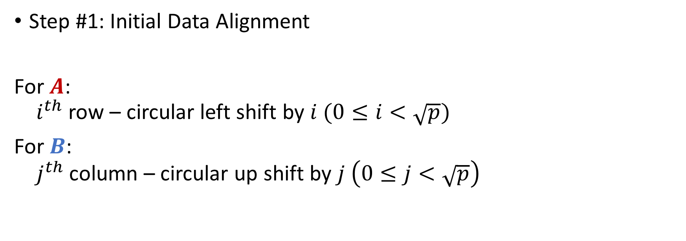
MM on 2D Mesh – Cannon’s Algorithm
Step #1: Initial Data Alignment
For $A$:
$i^{th}$ row – circular left shift by $i (0≤i<\sqrt{p})$
For $B$:
$j^{th}$ column – circular up shift by $j \left(0≤j<\sqrt{p}\right)$

Slide 21




























MM on 2D Mesh – Cannon’s Algorithm
Data Distributed after Step 1?
$$??$$
$$??$$
$$??$$
$$??$$
$$??$$
$$??$$
$$??$$
$$??$$
$$??$$
$$??$$
$$??$$
$$??$$
$$??$$
$$??$$
$$??$$
$$??$$
$$??$$
$$??$$
$$??$$
$$??$$
$$??$$
$$??$$
$$??$$
$$??$$
$$??$$
$$??$$
$$??$$
$$??$$
$$??$$
$$??$$
$$??$$
$$??$$

Slide 22
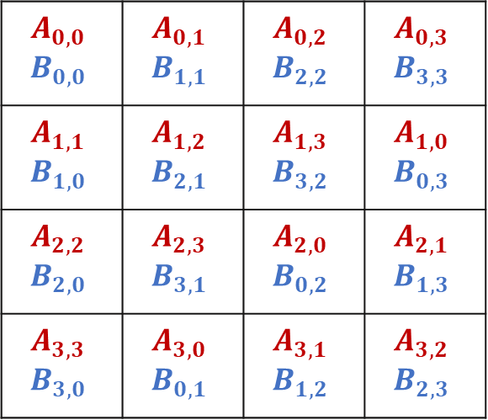
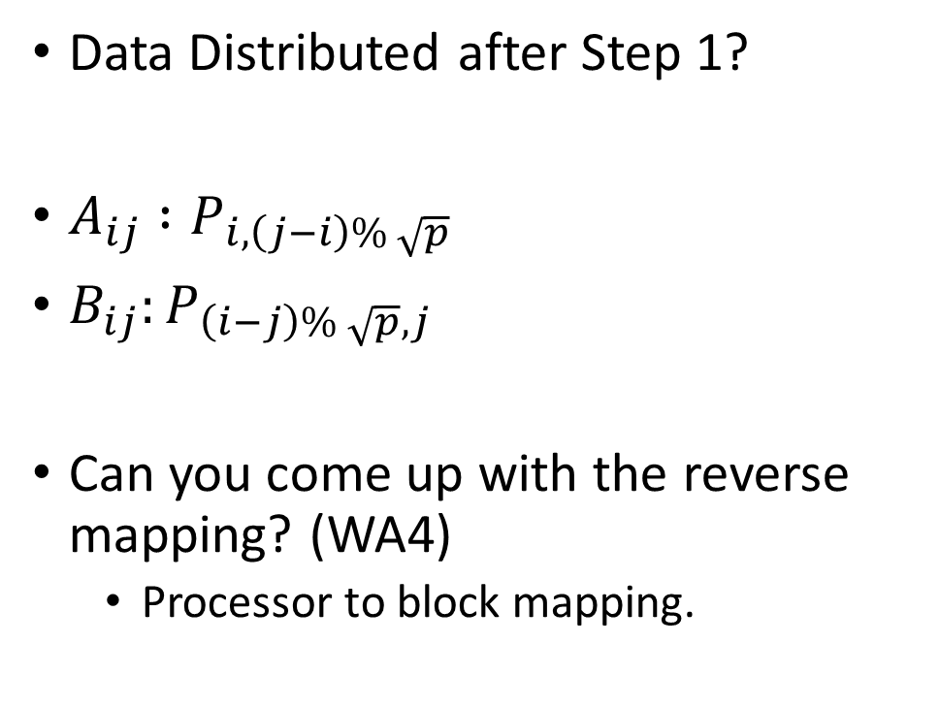
MM on 2D Mesh – Cannon’s Algorithm
Data Distributed after Step 1?
$A_{ij} :P_{i,\left(j−i\right)\% \sqrt{p}}$
$B_{ij}:P_{\left(i−j\right)\% \sqrt{p}, j}$
Can you come up with the reverse mapping? (WA4)
Processor to block mapping.
$$A_{0,0}$$ $$B_{0,0}$$ | $$A_{0,1}$$ $$B_{1,1}$$ | $$A_{0,2}$$ $$B_{2,2}$$ | $$A_{0,3}$$ $$B_{3,3}$$
$$A_{1,1}$$ $$B_{1,0}$$ | $$A_{1,2}$$ $$B_{2,1}$$ | $$A_{1,3}$$ $$B_{3,2}$$ | $$A_{1,0}$$ $$B_{0,3}$$
$$A_{2,2}$$ $$B_{2,0}$$ | $$A_{2,3}$$ $$B_{3,1}$$ | $$A_{2,0}$$ $$B_{0,2}$$ | $$A_{2,1}$$ $$B_{1,3}$$
$$A_{3,3}$$ $$B_{3,0}$$ | $$A_{3,0}$$ $$B_{0,1}$$ | $$A_{3,1}$$ $$B_{1,2}$$ | $$A_{3,2}$$ $$B_{2,3}$$

Slide 23
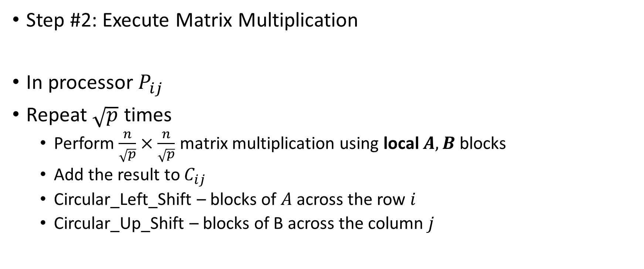
MM on 2D Mesh – Cannon’s Algorithm
Step #2: Execute Matrix Multiplication
In processor $P_{ij}$
Repeat $\sqrt{p}$ times
Perform $\frac{n}{\sqrt{p}}×\frac{n}{\sqrt{p}}$ matrix multiplication using local $A,B$ blocks
Add the result to $C_{ij}$
Circular_Left_Shift – blocks of $A$ across the row $i$
Circular_Up_Shift – blocks of B across the column $j$

Slide 24

























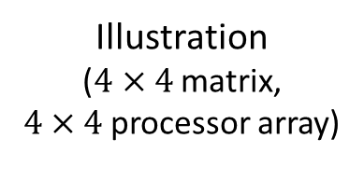
MM on 2D Mesh – Cannon’s Algorithm
Illustration
($4×4$matrix,
$4×4$processor array)
After Initial Alignment
Step 1
Compute product of local blocks
Circular left shift
Circular up shift
Repeat
$$A_{0,0}$$
$$A_{0,1}$$
$$A_{0,2}$$
$$A_{0,3}$$
$$B_{0,0}$$
$$B_{1,1}$$
$$B_{2,2}$$
$$B_{3,3}$$
$$A_{1,1}$$
$$A_{1,2}$$
$$A_{1,3}$$
$$A_{1,0}$$
$$B_{1,0}$$
$$B_{2,1}$$
$$B_{3,2}$$
$$B_{0,3}$$
$$A_{2,2}$$
$$A_{2,3}$$
$$A_{2,0}$$
$$A_{2,1}$$
$$B_{2,0}$$
$$B_{3,1}$$
$$B_{0,2}$$
$$B_{1,3}$$
$$A_{3,3}$$
$$A_{3,0}$$
$$A_{3,1}$$
$$A_{3,2}$$
$$B_{3,0}$$
$$B_{0,1}$$
$$B_{1,2}$$
$$B_{2,3}$$
$$B_{0,0}$$
$$B_{1,1}$$
$$B_{2,2}$$
$$B_{3,3}$$

Slide 25
































MM on 2D Mesh – Cannon’s Algorithm
$$A_{0,1}$$
$$A_{0,2}$$
$$A_{0,3}$$
$$A_{0,0}$$
After Initial Alignment
Step 2
Compute product of local blocks
Circular left shift
Circular up shift
Repeat
$$B_{1,0}$$
$$B_{2,1}$$
$$B_{3,2}$$
$$B_{0,3}$$
$$A_{1,2}$$
$$A_{1,3}$$
$$A_{1,0}$$
$$A_{1,1}$$
$$B_{2,0}$$
$$B_{3,1}$$
$$B_{0,2}$$
$$B_{1,3}$$
$$A_{2,3}$$
$$A_{2,0}$$
$$A_{2,1}$$
$$A_{2,2}$$
$$B_{3,0}$$
$$B_{0,1}$$
$$B_{1,2}$$
$$B_{2,3}$$
$$A_{3,0}$$
$$A_{3,1}$$
$$A_{3,2}$$
$$A_{3,3}$$
$$B_{0,0}$$
$$B_{1,1}$$
$$B_{2,2}$$
$$B_{3,3}$$
$$B_{0,0}$$
$$B_{1,1}$$
$$B_{2,2}$$
$$B_{3,3}$$

Slide 26






























MM on 2D Mesh – Cannon’s Algorithm
$$A_{0,2}$$
$$A_{0,3}$$
$$A_{0,0}$$
$$A_{0,1}$$
After Initial Alignment
Step 3
Compute product of local blocks
Circular left shift
Circular up shift
Repeat
$$B_{2,0}$$
$$B_{3,1}$$
$$B_{0,2}$$
$$B_{1,3}$$
$$A_{1,3}$$
$$A_{1,0}$$
$$A_{1,1}$$
$$A_{1,2}$$
$$B_{3,0}$$
$$B_{0,1}$$
$$B_{1,2}$$
$$B_{2,3}$$
$$A_{2,0}$$
$$A_{2,1}$$
$$A_{2,2}$$
$$A_{2,3}$$
$$B_{0,0}$$
$$B_{1,1}$$
$$B_{2,2}$$
$$B_{3,3}$$
$$A_{3,1}$$
$$A_{3,2}$$
$$A_{3,3}$$
$$A_{3,0}$$
$$B_{1,0}$$
$$B_{2,1}$$
$$B_{3,2}$$
$$B_{0,3}$$
$$B_{0,0}$$
$$B_{1,1}$$
$$B_{2,2}$$
$$B_{3,3}$$

Slide 27















MM on 2D Mesh – Cannon’s Algorithm
$$A_{0,3}$$
$$A_{0,0}$$
$$A_{0,1}$$
$$A_{0,2}$$
After Initial Alignment
Step 4
Compute product of local blocks
Circular left shift
Circular up shift
End
$$B_{3,0}$$
$$B_{0,1}$$
$$B_{1,2}$$
$$B_{2,3}$$
$$A_{1,0}$$
$$A_{1,1}$$
$$A_{1,2}$$
$$A_{1,3}$$
$$B_{0,0}$$
$$B_{1,1}$$
$$B_{2,2}$$
$$B_{3,3}$$
$$A_{2,1}$$
$$A_{2,2}$$
$$A_{2,3}$$
$$A_{2,0}$$
$$B_{1,0}$$
$$B_{2,1}$$
$$B_{3,2}$$
$$B_{0,3}$$
$$A_{3,2}$$
$$A_{3,3}$$
$$A_{3,0}$$
$$A_{3,1}$$
$$B_{2,0}$$
$$B_{3,1}$$
$$B_{0,2}$$
$$B_{1,3}$$
$$B_{0,0}$$
$$B_{1,1}$$
$$B_{2,2}$$
$$B_{3,3}$$

Slide 28
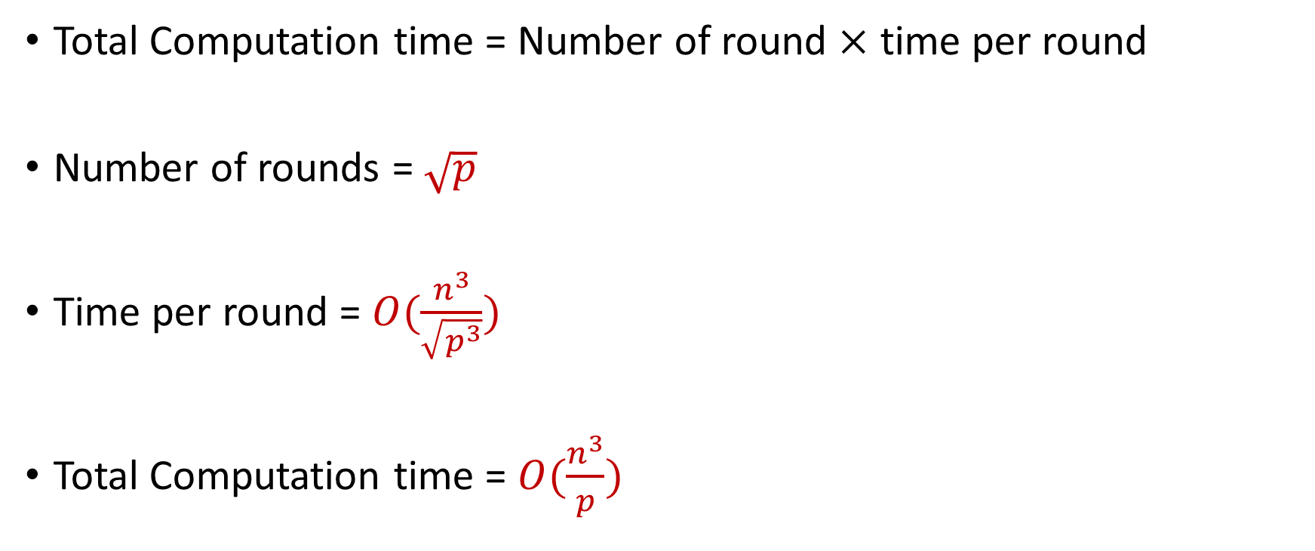
Performance Analysis (1)
Total Computation time = Number of round $×$ time per round
Number of rounds = $\sqrt{p}$
Time per round = $O(\frac{n^{3}}{\sqrt{p^{3}}})$
Total Computation time = $O(\frac{n^{3}}{p})$

Slide 29
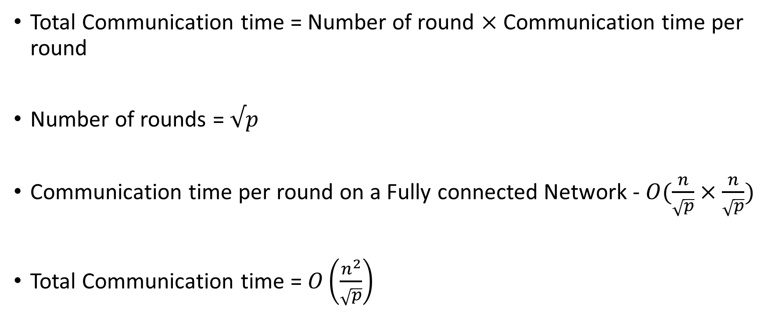
Performance Analysis (2)
Total Communication time = Number of round $×$ Communication time per round
Number of rounds = $√p$
Communication time per round on a Fully connected Network - $O(\frac{n}{\sqrt{p}}×\frac{n}{\sqrt{p}})$
Total Communication time = $O\left(\frac{n^{2}}{\sqrt{p}}\right)$

Slide 30
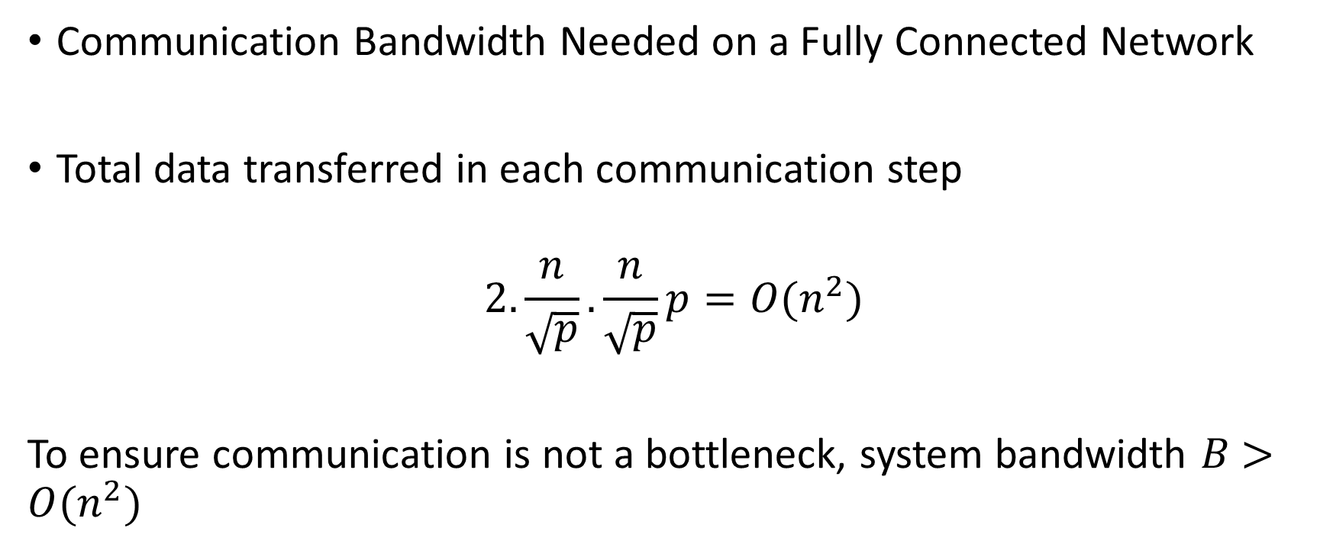
Performance Analysis (3)
Communication Bandwidth Needed on a Fully Connected Network
Total data transferred in each communication step
$$2.\frac{n}{\sqrt{p}}.\frac{n}{\sqrt{p}}p=O(n^{2})$$
To ensure communication is not a bottleneck, system bandwidth $B$ $>O(n^{2})$

Slide 31

Performance Analysis (4)
In other words, the largest size of matrix that can be solved using $p$ processors on this system, using this algorithm is:
$$\sqrt{B}×√B$$

Slide 32
Collective Communication (1)
Writing programs with send/receive can get too cumbersome
Difficult to optimize
If every process needs to be involved in communication, a higher level of abstraction is desired
Collective Communication API: Communications involving group of processors

Slide 33
Collective Communication (2)
Called by ALL the processors
Each processor should call the same API with same size of buffer
If a call is missing in one of the processors, it may lead to undefined behavior
One program in EACH processor reaches the call, the communication occurs
Examples
Barrier Synchronization (usually not used because other communication operations lead to synchronization)
Broadcast, Scatter, Gather, …
Reduction, All_reduce,…

Slide 34
MPI_Broadcast
Note: ALL processors are calling this function
MPI_Broadcast(buffer, size, root)
Send the data stored in buffer at the root processor to all the processors
Notes:
Image source: https://fs.hlrs.de/projects/par/par_prog_ws/pdf/mpi_3.1_rab.pdf

Slide 35
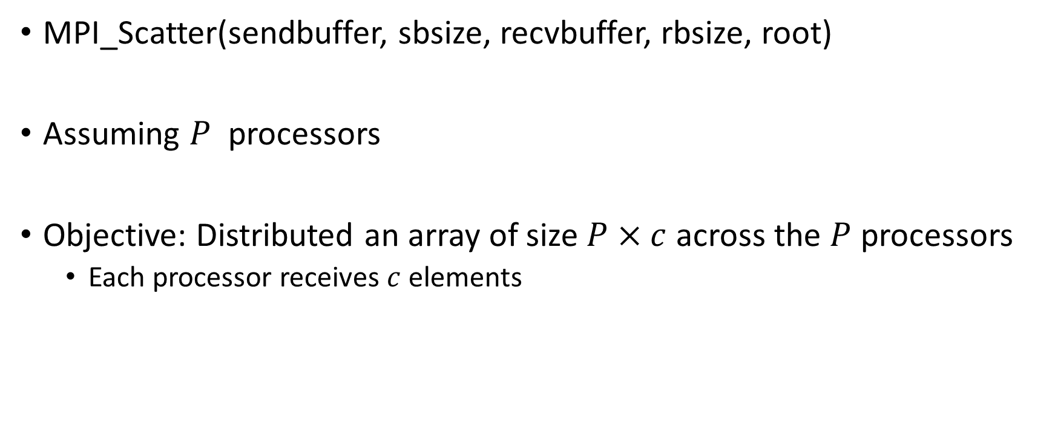
MPI_Scatter
MPI_Scatter(sendbuffer, sbsize, recvbuffer, rbsize, root)
Assuming $P$ processors
Objective: Distributed an array of size $P×c$ across the $P$ processors
Each processor receives $c$ elements

Slide 36
MPI_Scatter

Slide 37
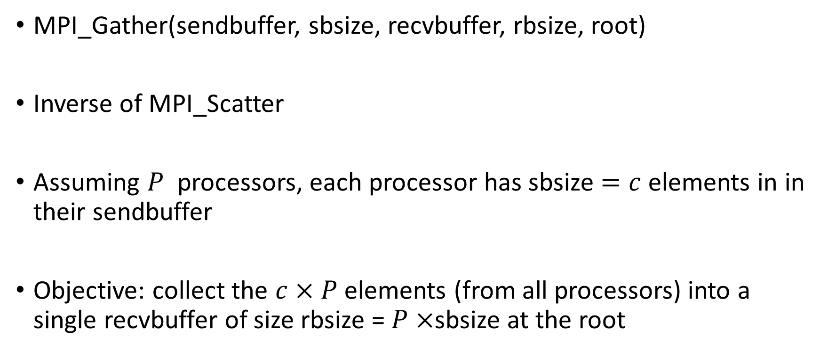
MPI_Gather
MPI_Gather(sendbuffer, sbsize, recvbuffer, rbsize, root)
Inverse of MPI_Scatter
Assuming $P$ processors, each processor has sbsize $=c$ elements in in their sendbuffer
Objective: collect the $c×P$ elements (from all processors) into a single recvbuffer of size rbsize = $P×$sbsize at the root

Slide 38
MPI_Gather

Slide 39
MPI_Reduce
MPI_Reduce(inbuf, ibsize, resultbuf, rbsize, Aggr_op, root)
Performs a global reduction operation with a specified aggregation function and stores the result at the root
Inbuf: buffer that stores elements in each processor that will be aggregated
Resultbuf: buffer in the root processor that stores the aggregated results

Slide 40
MPI_Reduce

Slide 41
MPI_AllReduce
MPI_AllReduce(inbuf, resultbuf, size)
Same as MPI_Reduce() but stores the results in all the processors
Equivalent to:
MPI_Reduce(inbuf, ibsize, resultbuf, rbsize, Aggr_op, root)
MPI_Broadcast(resultbuf, rbsize, root )

Slide 42
Outline
Collective Communication Primitives – Complexity Analysis

Slide 43
Collective Operations Communication Complexity (1)
Objective: Calculate how much time (in order notation) it takes to implement a communication primitive
Assumptions
Computation and other overheads are ignored
Fully Connected Interconnect – Communication between any pair of processors takes the same amount of time
Allows us to compare communication times of different distributed algorithm
Example: Cannon’s algorithm vs some other matrix multiplication algorithm (SUMMA – another distributed matrix multiplication algorithm: )

Slide 44
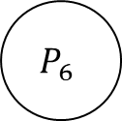
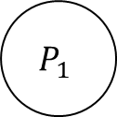
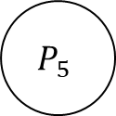
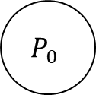
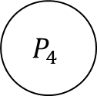
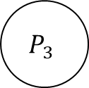

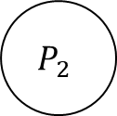
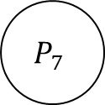
MPI_Broadcast
Can you think about what would be an efficient way?
Notice:
Communication between any pair takes the same amount of time
Multiple pairs can communicate at any given time
A Processor can do one send and one receive at any given time
$$P_{0}$$
$$P_{1}$$
$$P_{2}$$
$$P_{3}$$
$$P_{4}$$
$$P_{5}$$
$$P_{6}$$
$$P_{7}$$
Data initially at $P_{0}$

Slide 45
MPI_Broadcast
How about this approach?
$$P_{0}$$
$$P_{1}$$
$$P_{2}$$
$$P_{3}$$
$$P_{4}$$
$$P_{5}$$
$$P_{6}$$
$$P_{7}$$
Data initially at $P_{0}$

Slide 46
MPI_Broadcast
How about this approach?
$$P_{0}$$
$$P_{1}$$
$$P_{2}$$
$$P_{3}$$
$$P_{4}$$
$$P_{5}$$
$$P_{6}$$
$$P_{7}$$
Data initially at $P_{0}$

Slide 47
MPI_Broadcast
How about this approach?
…
$$P_{0}$$
$$P_{1}$$
$$P_{2}$$
$$P_{3}$$
$$P_{4}$$
$$P_{5}$$
$$P_{6}$$
$$P_{7}$$
Data initially at $P_{0}$

Slide 48
MPI_Broadcast
How about this approach?
Total communication complexity?
…
$$P_{0}$$
$$P_{1}$$
$$P_{2}$$
$$P_{3}$$
$$P_{4}$$
$$P_{5}$$
$$P_{6}$$
$$P_{7}$$
Data initially at $P_{0}$

Slide 49
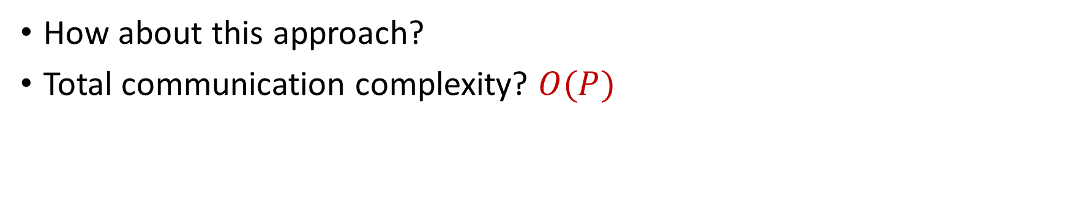
MPI_Broadcast
How about this approach?
Total communication complexity? $O(P)$
…
$$P_{0}$$
$$P_{1}$$
$$P_{2}$$
$$P_{3}$$
$$P_{4}$$
$$P_{5}$$
$$P_{6}$$
$$P_{7}$$
Data initially at $P_{0}$

Slide 50
MPI_Broadcast
Can we do better?
…
$$P_{0}$$
$$P_{1}$$
$$P_{2}$$
$$P_{3}$$
$$P_{4}$$
$$P_{5}$$
$$P_{6}$$
$$P_{7}$$
Data initially at $P_{0}$

Slide 51
MPI_Broadcast
Can we do better? Recursive Doubling
…
$$P_{0}$$
$$P_{1}$$
$$P_{2}$$
$$P_{3}$$
$$P_{4}$$
$$P_{5}$$
$$P_{6}$$
$$P_{7}$$
Data initially at $P_{0}$

Slide 52
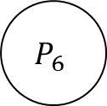
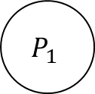
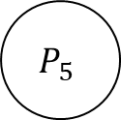
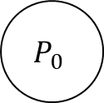
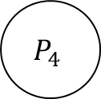
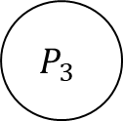

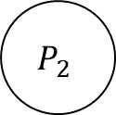
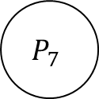
MPI_Broadcast
$$P_{0}$$
$$P_{1}$$
$$P_{2}$$
$$P_{3}$$
$$P_{4}$$
$$P_{5}$$
$$P_{6}$$
$$P_{7}$$
Data initially at $P_{0}$

Slide 53
MPI_Broadcast
$$P_{0}$$
$$P_{1}$$
$$P_{2}$$
$$P_{3}$$
$$P_{4}$$
$$P_{5}$$
$$P_{6}$$
$$P_{7}$$
Step 1

Slide 54
MPI_Broadcast
$$P_{0}$$
$$P_{1}$$
$$P_{2}$$
$$P_{3}$$
$$P_{4}$$
$$P_{5}$$
$$P_{6}$$
$$P_{7}$$
Step 2

Slide 55
MPI_Broadcast
$$P_{0}$$
$$P_{1}$$
$$P_{2}$$
$$P_{3}$$
$$P_{4}$$
$$P_{5}$$
$$P_{6}$$
$$P_{7}$$
Step 3

Slide 56

MPI_Broadcast
MPI_Broadcast Communication Complexity??
$t_{w}:$ size of data to broadcast
$P$: Number of processors
Algorithm proceeds in $\log{P}$ steps, each step communicates $t_{w}$ amount of data

Slide 57

MPI_Broadcast
MPI_Broadcast: $O(t_{w}×log{P)}$
$t_{w}:$ size of data to broadcast
$P$: Number of processors
Algorithm proceeds in $\log{P}$ steps, each step communicates $t_{w}$ amount of data

Slide 58

MPI_Scatter
$$P_{0}$$
$$P_{1}$$
$$P_{2}$$
$$P_{3}$$
$$P_{4}$$
$$P_{5}$$
$$P_{6}$$
$$P_{7}$$
Data initially at $P_{0}$
Notice the size

Slide 59
MPI_Scatter
Can you think about what would be an efficient way?
Key Idea: You want to maximize the number of pairs that communicate
$$P_{0}$$
$$P_{1}$$
$$P_{2}$$
$$P_{3}$$
$$P_{4}$$
$$P_{5}$$
$$P_{6}$$
$$P_{7}$$
Data initially at $P_{0}$
Notice the size

Slide 60
MPI_Scatter
Again Recursive Doubling
$$P_{0}$$
$$P_{1}$$
$$P_{2}$$
$$P_{3}$$
$$P_{4}$$
$$P_{5}$$
$$P_{6}$$
$$P_{7}$$
Data initially at $P_{0}$
Notice the size

Slide 61
MPI_Scatter
Again Recursive Doubling
$$P_{0}$$
$$P_{1}$$
$$P_{2}$$
$$P_{3}$$
$$P_{4}$$
$$P_{5}$$
$$P_{6}$$
$$P_{7}$$
Step 1

Slide 62
MPI_Scatter
Again Recursive Doubling
$$P_{0}$$
$$P_{1}$$
$$P_{2}$$
$$P_{3}$$
$$P_{4}$$
$$P_{5}$$
$$P_{6}$$
$$P_{7}$$
Step 2

Slide 63
MPI_Scatter
Again Recursive Doubling
$$P_{0}$$
$$P_{1}$$
$$P_{2}$$
$$P_{3}$$
$$P_{4}$$
$$P_{5}$$
$$P_{6}$$
$$P_{7}$$
Step 3

Slide 64
MPI_Scatter
Can you calculate the communication complexity?
$$P_{0}$$
$$P_{1}$$
$$P_{2}$$
$$P_{3}$$
$$P_{4}$$
$$P_{5}$$
$$P_{6}$$
$$P_{7}$$
Step 3

Slide 65

MPI_Scatter
Can you calculate the communication complexity?
$\frac{P}{2}+\frac{P}{4}+\frac{P}{8}…. 1=$
$$P_{0}$$
$$P_{1}$$
$$P_{2}$$
$$P_{3}$$
$$P_{4}$$
$$P_{5}$$
$$P_{6}$$
$$P_{7}$$
Step 3

Slide 66
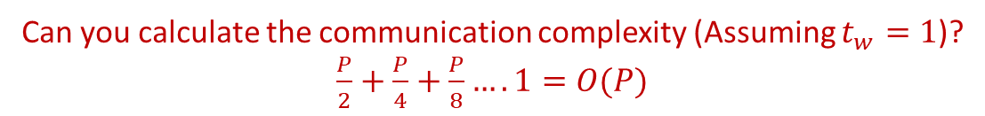
MPI_Scatter
Can you calculate the communication complexity (Assuming $t_{w}=1$)?
$\frac{P}{2}+\frac{P}{4}+\frac{P}{8}…. 1=O(P)$
$$P_{0}$$
$$P_{1}$$
$$P_{2}$$
$$P_{3}$$
$$P_{4}$$
$$P_{5}$$
$$P_{6}$$
$$P_{7}$$
Step 3

Slide 67

MPI_Gather
Inverse of MPI_Scatter
Complexity: $O(P)$

Slide 68
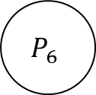
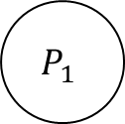
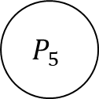
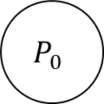
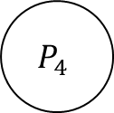




MPI_Reduce
Can you think about what would be an efficient way?
Key Idea: You want to maximize the number of pairs that communicate
$$P_{0}$$
$$P_{1}$$
$$P_{2}$$
$$P_{3}$$
$$P_{4}$$
$$P_{5}$$
$$P_{6}$$
$$P_{7}$$
Initial data. Need to store the Aggregate at $P_{0}$

Slide 69
MPI_Reduce
$$P_{0}$$
$$P_{1}$$
$$P_{2}$$
$$P_{3}$$
$$P_{4}$$
$$P_{5}$$
$$P_{6}$$
$$P_{7}$$
Step 1

Slide 70
MPI_Reduce
$$P_{0}$$
$$P_{1}$$
$$P_{2}$$
$$P_{3}$$
$$P_{4}$$
$$P_{5}$$
$$P_{6}$$
$$P_{7}$$
Step 1

Slide 71
MPI_Reduce
$$P_{0}$$
$$P_{1}$$
$$P_{2}$$
$$P_{3}$$
$$P_{4}$$
$$P_{5}$$
$$P_{6}$$
$$P_{7}$$
Step 2

Slide 72
MPI_Reduce
$$P_{0}$$
$$P_{1}$$
$$P_{2}$$
$$P_{3}$$
$$P_{4}$$
$$P_{5}$$
$$P_{6}$$
$$P_{7}$$
Step 2

Slide 73
MPI_Reduce
$$P_{0}$$
$$P_{1}$$
$$P_{2}$$
$$P_{3}$$
$$P_{4}$$
$$P_{5}$$
$$P_{6}$$
$$P_{7}$$
Step 3

Slide 74
MPI_Reduce
$$P_{0}$$
$$P_{1}$$
$$P_{2}$$
$$P_{3}$$
$$P_{4}$$
$$P_{5}$$
$$P_{6}$$
$$P_{7}$$
Step 3

Slide 75
MPI_Reduce
Can you calculate the communication complexity?
$$P_{0}$$
$$P_{1}$$
$$P_{2}$$
$$P_{3}$$
$$P_{4}$$
$$P_{5}$$
$$P_{6}$$
$$P_{7}$$
Step 3

Slide 76

MPI_Reduce
Can you calculate the communication complexity?
1 + 1 + … 1 ($\log{P)}$times = $O(\log{P)}$
$$P_{0}$$
$$P_{1}$$
$$P_{2}$$
$$P_{3}$$
$$P_{4}$$
$$P_{5}$$
$$P_{6}$$
$$P_{7}$$
Step 3

Slide 77
Implementing Algorithms using Communication Primitives
Sum of Algorithms on 1D Array: ??

Slide 78

Implementing Algorithms using Communication Primitives
Sum of Algorithms on 1D Array: MPI_Reduce(inbuf, 1,resultbuf,1,SUM, 0)
Communication Complexity - $O(\log{P)}$

Slide 79

Implementing Algorithms using Communication Primitives
Calculate the average of an array of size $P$ using $P$ processors
Initial data mapping: Each processor owns one element of the array
Approach #1:
P0 performs MPI_Gather
P0 calculates the average of the gathered array
P0 performs MPI_Scatter of the average
What is the communication complexity?
Ungraded HW Assignment (may ask in WA 4)

Slide 80

Collective Communication Operation Example
Approach #2
P0 performs MPI_Reduce with MPI_SUM as aggregation operation
P0 divides the aggregated value by $P$ (number of processors) to obtain
P0 performs MPI_Broadcast of the average
What is the communication time?
Ungraded HW Assignment (may ask in WA 4)
Which approach is better?

Slide 81
Next Class
11/20 Lecture 23
Distribute Training Parallelism Paradigms – Implementation Using Communication Primitives

Slide 82
Thank You
Questions?
Email: sanmukh.kuppannagari@case.edu

